Slide 1



IT Brown Bag CCoE Interns Summer 2019 rhAid
Divya Karthik
Harrison Noble
Katarina Springer
Notes:
First and last names
Change the text or something, its empty…

Slide 2



ABOUT US
KATARINA SPRINGER
DIVYA KARTHIK
HARRISON NOBLE
College: UC Santa Cruz
Major: Computer Science
Hometown: San Ramon, CA
College: UC Davis
Major: Computer Science and Engineering
Hometown: Pleasanton, CA
College: Southern Methodist University
Major: Computer Science
Hometown: Danville, CA
Notes:
Talk about our approach –
“Startup” technique
Chose from a list of projects
etc.
Why did we choose rhAid?

Slide 3
Introduction
rhAid was made using a start-up approach.
We were given 4 choices for projects:
Incident management system
Contract management system
Flow log analysis
IoT button "buzzers“
We chose to work on the incident management system because it seemed the most interesting to us, as well as being a practical and real-life applicable project
Our project was developed in the AWS cloud
Notes:
Talk about our approach –
“Startup” technique
Chose from a list of projects
etc.
Why did we choose rhAid?

Slide 4
What is rhAid?
When faced with an issue, an employee might submit a support ticket through AWS, ServiceNow, or Jira. Most likely, the user would prefer searching resolved cases for a quick solution before submitting a new ticket.
However, resolved tickets are not organized and are not all accessible from one location.
rhAid will not only pool tickets into one standard formatted location, but also use machine learning to automatically suggest and link to resolved tickets relating to similar problems.
This will reduce time spent solving common issues and reduce the number of repeated support tickets.
Notes:
Start with the problem
Do a quick walkthrough –
One person logs a ticket and it gets resolved, 6 months later someone else logs the same ticket but don’t leverage any learnings from the first ticket
Find some metrics –
how many tickets have been logged in the past
give context to how much work there is

Slide 5
Our Solution
Figure out a storage solution for centralizing all the support cases from each service platform.
1
Agree on useful data we would extract from each support case.
2
Communicate with users who recently submitted support tickets.
4
Develop a user interface so employees can view historical ticket data.
5
Find a solution to retrieve all the tickets as well as an efficient way to extract useful information.
3
Notes:
Start with the problem
Do a quick walkthrough –
One person logs a ticket and it gets resolved, 6 months later someone else logs the same ticket but don’t leverage any learnings from the first ticket
Find some metrics –
how many tickets have been logged in the past
give context to how much work there is

Slide 6
Live Demo
Submitting a Ticket
Receiving an Email
Reviewing the UI
Notes:
James suggestaed we move this to the beginning to give context for what we are talking about later on

Slide 7
Our Approach
We used the Minimum viable product method when creating rhAid.
Baseline functionality is priority, additional features come after.
Our MVP involved storing and analyzing AWS tickets, and creating a user interface.
We started by creating a baseline architecture and expanding off it.

Slide 8
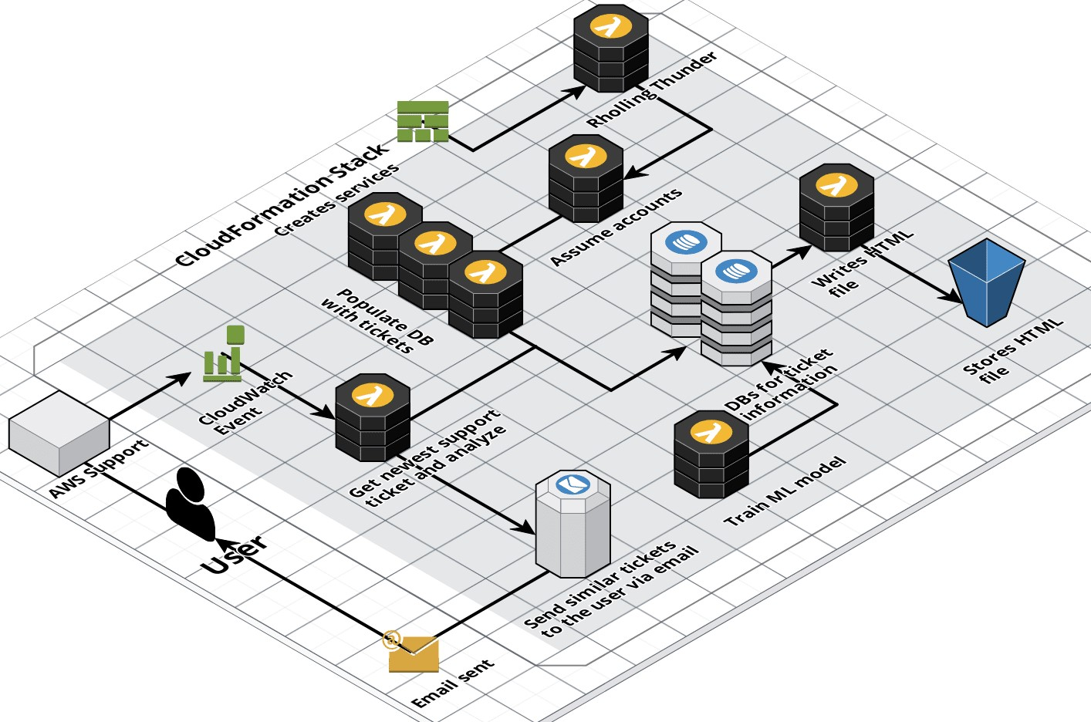
The Architecture
Services used to create rhAid
z
Notes:
Did the architecture change? (maybe include pics of previous versions too)
Did we learn anything new?

Slide 9
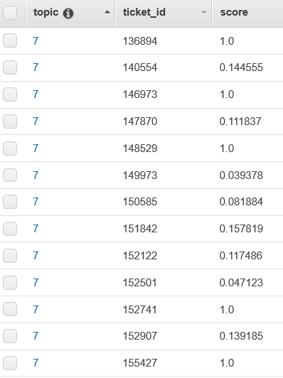
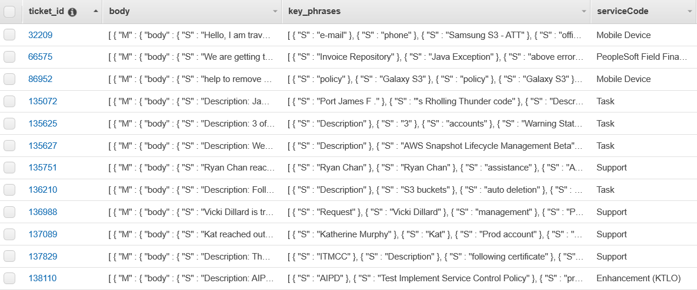
The Data
Used APIs from AWS, Jira, and ServiceNow to get the data
Still working on SNow and Jira API so we are currently pulling those support tickets from a CSV
Notes:
Did the data schema change? Did we learn something that changed this?
Why did we pick those three sources? (I think this refers to jira aws and servicenow)
How are we filtering the data
What is the purpose of normalizing the data?

Slide 10
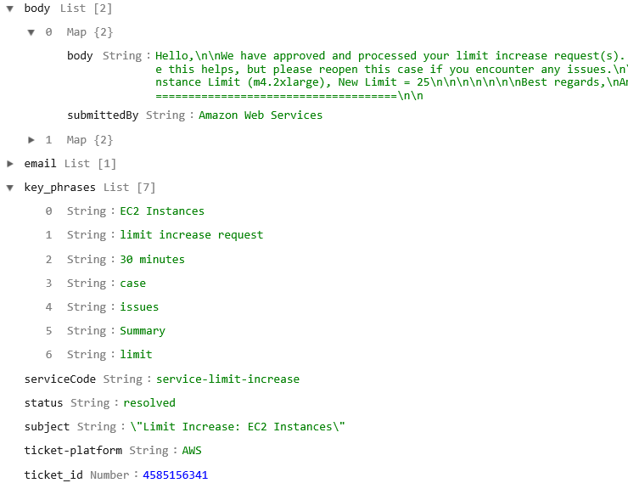
The Data
Example of the structured data in the DynamoDB
Photo of individual
Ticket's Fields

Slide 11
PROCESSING TICKETS - MACHINE LEARNING
The Goal:
Returning similar tickets from our database for a newly posted ticket.
Technologies used:
AWS Comprehend
- Detects Key Phrases
- Detects Entities
- Detects Syntax
- Detects Sentiment
- Topic Modeling
AWS Sagemaker
- Platform to build, train and deploy models
- Comes with sample algorithm implementations
(3)
Using AWS Comprehend Topic Modeling
(2)
Using the Sagemaker LDA algorithm
(1)
Sagemaker’s Word2Vec Algorithm
Our ML Process Map
Notes:
So the next big step after we had our data, was to process the tickets. For our purposes, the goal for using machine learning was to return similar tickets from our database for a newly posted ticket. And while we could do this manually by hard coding if and else statements and comparing the words in the body, using machine learning was efficient in the way that it brought the context of the tickets into the picture. Within AWS Web Services, the two ML services we used were AWS Sagemaker and AWS Comprehend. Sagemaker is a platform to build train and deploy models and it comes with sample algorithms. AWS Comprehend is a natural language processing service that uses ML behind the scenes so no training or tuning is required.
With ML, our main challenge was finding the right approach. The main work was making the input just right so our results fell in our desired range.
Here you can see the different implementations we tried and the one we ended up using, so let’s start with our first approach.

Slide 12
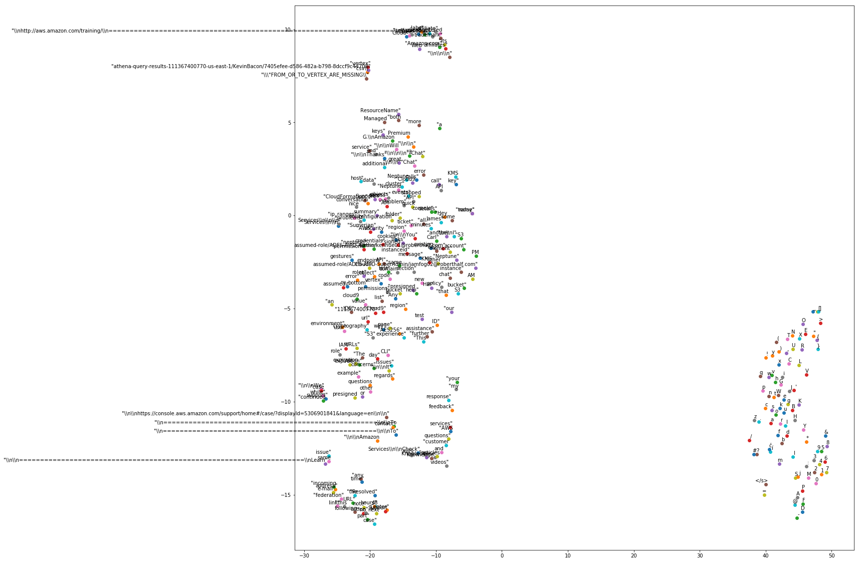
PROCESSING TICKETS - MACHINE LEARNING
Using AWS Comprehend Topic Modeling
Using the Sagemaker LDA algorithm
SageMaker’s Word2Vec Algorithm
WORDS
VECTORS
HIDDEN LAYER MATRIX MULTIPLICATION
COSINE ANALYSIS OF THESE RESULTANT VECTORS
Sagemaker Word2Vec did not give us the output format we were looking for.
Words grouping instead of ticket grouping.
No easy or straightforward way to make use of the word groupings for our purposes.
Notes:
So when we got our project the first recommendation was to use Sagemaker’s Obj2Vec algorithm, so that was our first approach.
. The input for the algorithm required us to to input each ticket and convert it into vector format. And based on cosine comparison of the text, it would give us a result. The problem with sagemaker was that instead of vectorizing each ticket so we could compare the tickets, it vectorized the content and was only able to do

Slide 13
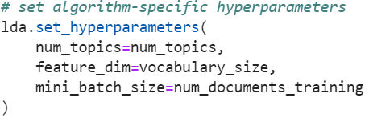
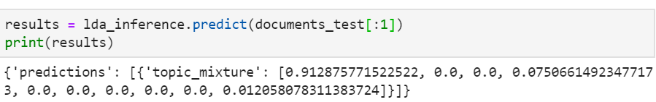
PROCESSING TICKETS - MACHINE LEARNING
Using AWS Comprehend Topic Modeling
Using the Sagemaker LDA algorithm
Ticket | Key Phrases | Vocab Words Accumulated
1 | RDS, database, storage, cells, key, delete, populate, database, key, storage | 7 (3 repeats)
2 | S3, storage, storage, delete, bucket, tags, create | 4 (3 repeats)
3 | role, instance, security, create, tags, delete, role instance | 3 (5 repeats)
SageMaker’s Word2Vec Algorithm
(1) Format Ticket’s Key Phrases to feed into LDA
rds | database | storage | cells | key | delete | populate | s3 | bucket | tags | create | role | instance | security
1 | 2 | 2 | 1 | 2 | 1 | 1 | 0 | 0 | 0 | 0 | 0 | 0 | 0
0 | 0 | 2 | 0 | 0 | 1 | 0 | 1 | 1 | 1 | 1 | 0 | 0 | 0
0 | 0 | 0 | 0 | 0 | 1 | 0 | 0 | 0 | 1 | 1 | 2 | 2 | 1
(2) Input Three Required Parameters
Sagemaker LDA did not have topic distributions for tickets we trained the data with, tickets which may have been potential solutions to new tickets.
Also there was no way to visualize what each topic was about.
There was no easy way to test whether a prediction was accurate as we couldn’t see what other tickets were placed in that topic grouping.
(3) Call model to see topic distribution of a ticket
Notes:
So the LDA algorithm was exactly what we were looking for: topic modeling. The LDA algorithms input was simple the number of documents, the documents themselves so one ticket per text file, and the number of topics. That’s when we ran into our first problem because while we did want to group individual tickets, we did not know or care about how many topics we got. So our way out of this was trial and error, entering different number of topics as an input until our final output made sense. Additionally training an LDA model requires atleast 1000 tickets, and with LDA, the topics you train with aren’t given a distribution.
But right as we were about to begin this grunt work, we spoke to another AWS expert who suggested an even better solution: An LDA ready made model that AUTOMATICALLY generates the number of topics – this was in front of our eyes all along AWS Comprehend Topic Modeling.

Slide 14
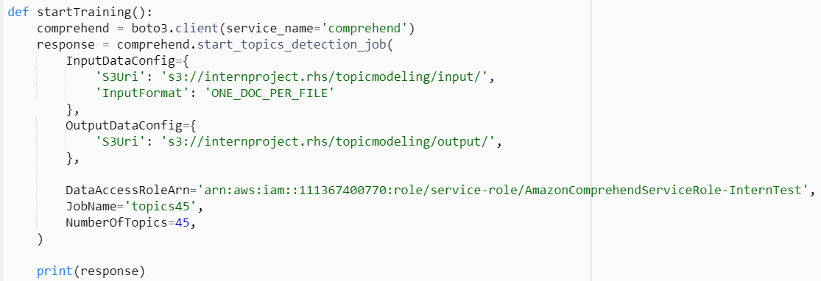
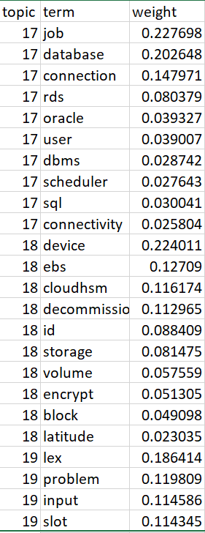
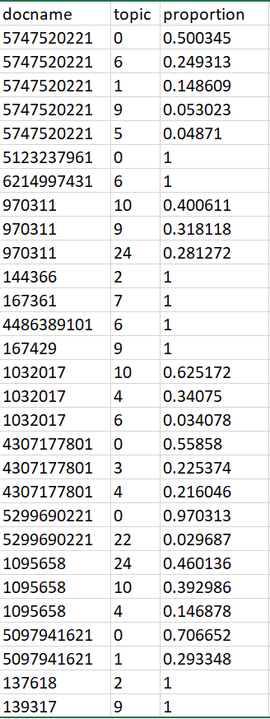
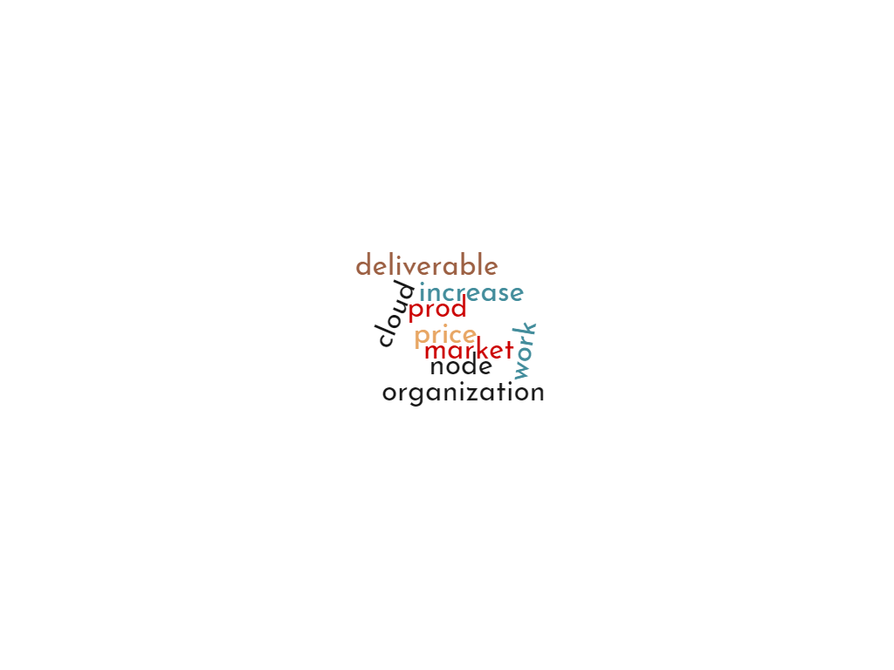
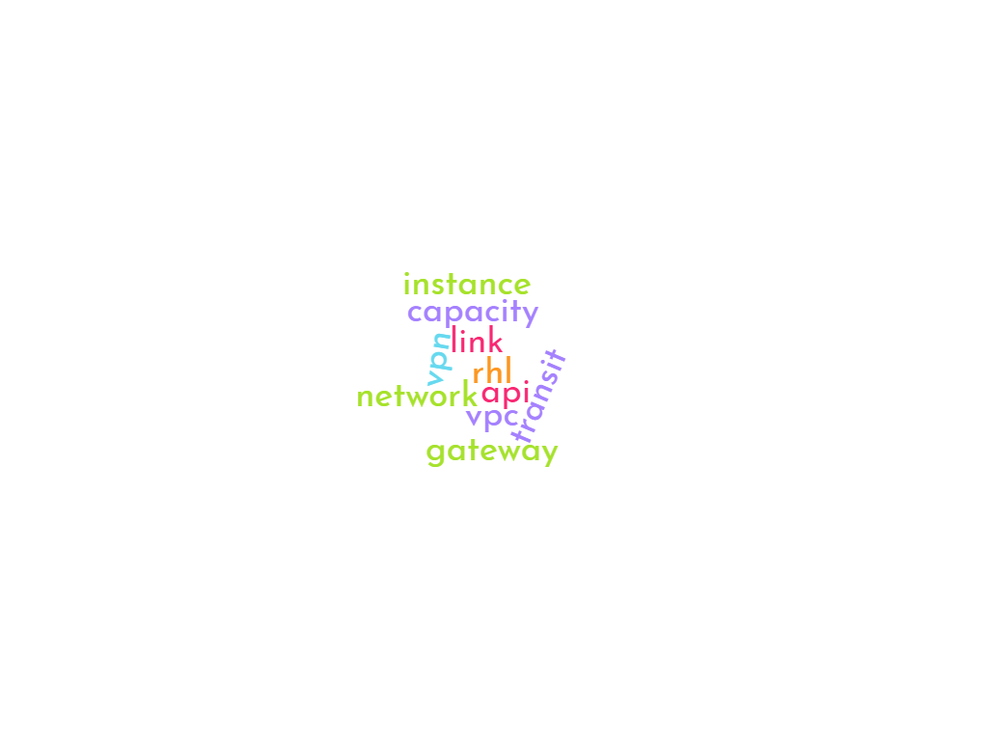


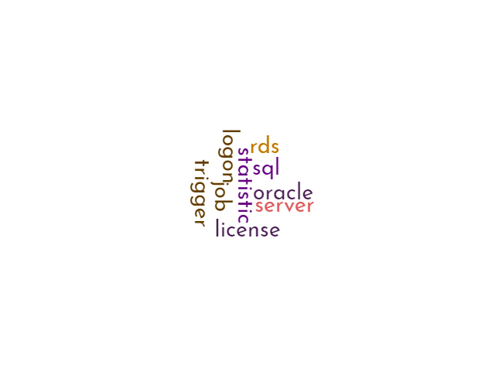
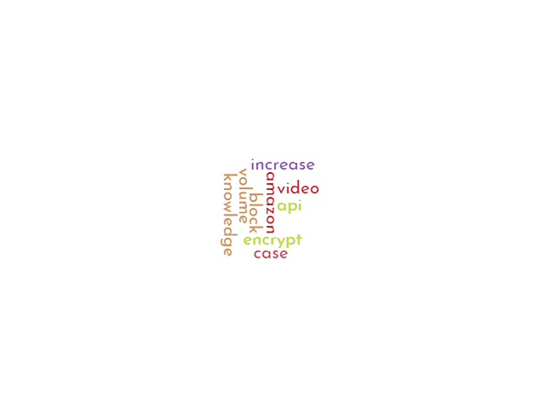
PROCESSING TICKETS - MACHINE LEARNING
Using AWS Comprehend Topic Modeling
Calling AWS Comprehend Topic Modeling
Using the Sagemaker LDA algorithm
SageMaker’s Word2Vec Algorithm
O
U
T
P
U
T
Some Topic Groupings Visualized
Do you think the ML did a good job?
List of prominent words each topic contains
Each Ticket Classified into most fitting topics
Notes:
So AWS Comprehend Topic Modeling is LDA behind the scenes, it’s different from running an LDA algorithm in Sagemaker since instead of outputting a model we can “call” and run our new ticket through to place it in a group, we would simply get a two CSV files and from there when we got a new ticket we would have to manually write code to use the results from the CSV. This was not our original plan but we realized it was the best way to go because yes even though ML didn’t do all the work for us, having a manual comparison algorithm might have even been helpful as it dosen’t rely on the machine to do all the computing and it’s can be counted on reliable and trusted results all time.

Slide 15
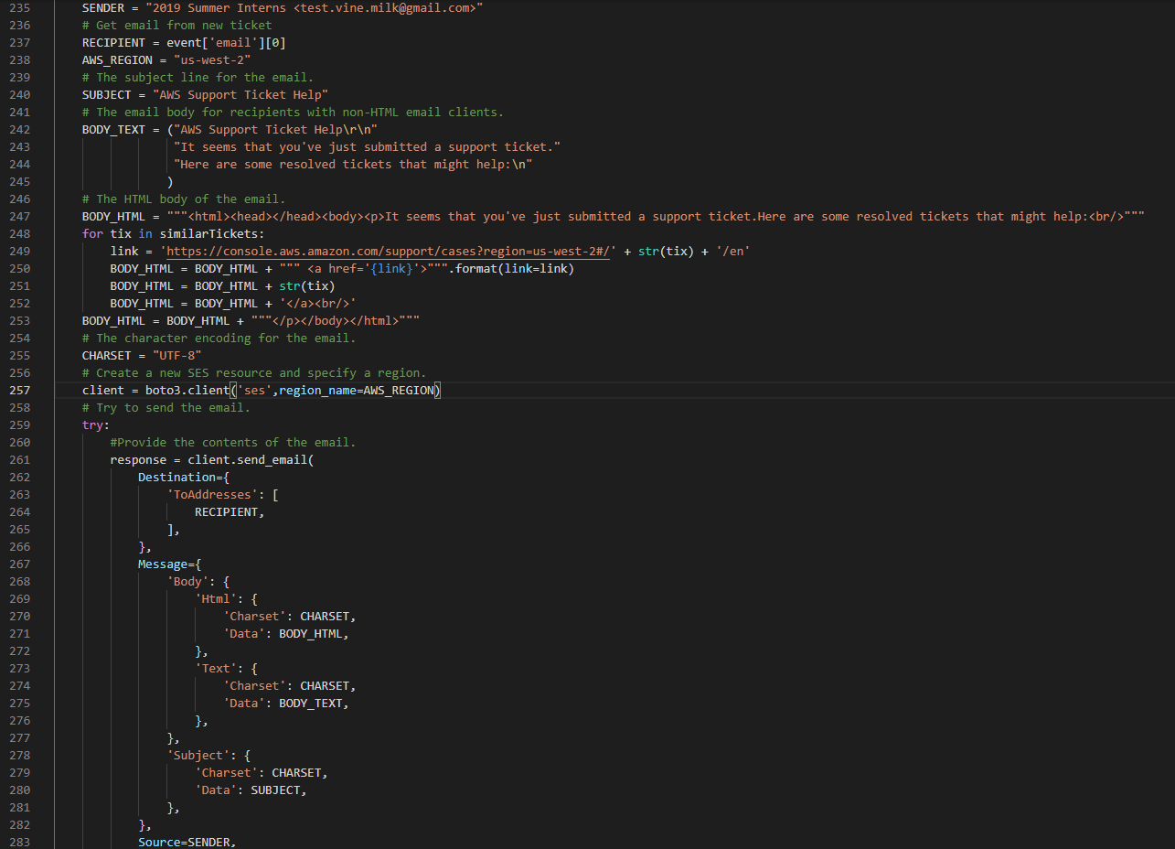
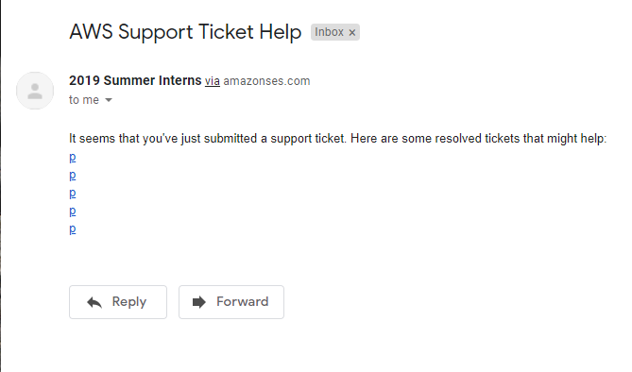
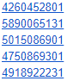
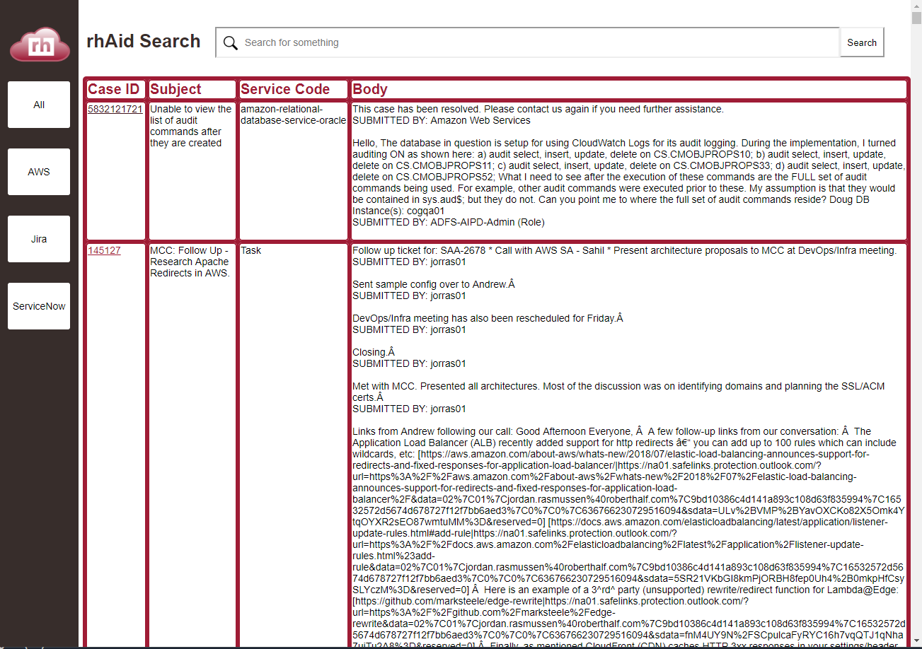
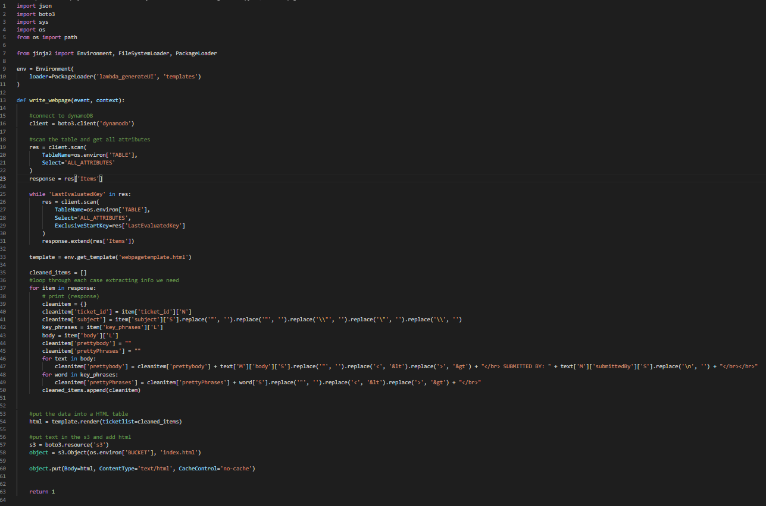
The UI
The webpage is hosted in a static s3 bucket
The html file is generated using a lambda function and a jinja template.
This allows us to easily make changes to the webpage as well as updating the information automatically.
We used SES to send an email to users that submit new tickets
Similar tickets are found and linked in the text.
Like the webpage, the email is generated and sent by a lambda function.

Slide 16
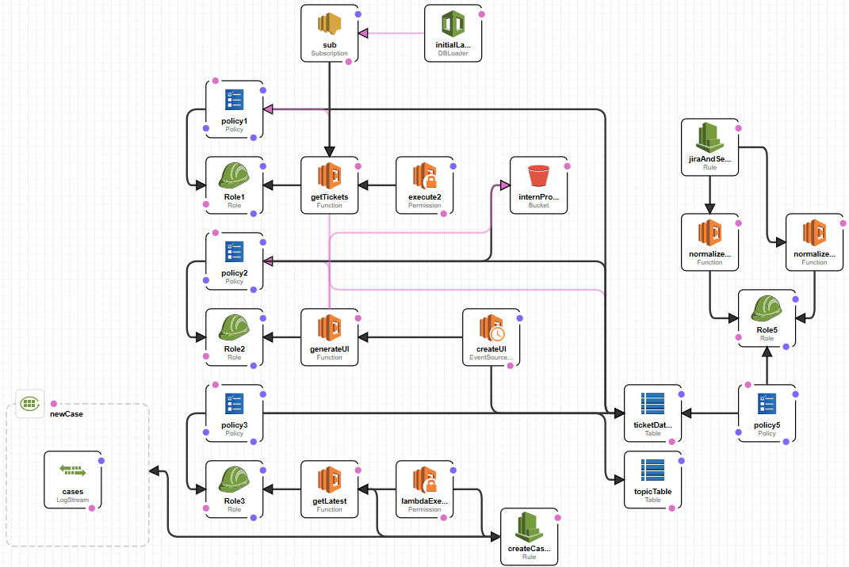
The Automation
Visualization of CloudFormation script
Notes:
Was it worth it to script?
Why did we automate

Slide 17












Summary
The AWS Services we used were:
We also gained experience with other tools, such as:
Learning about AWS was fun and interesting.
However, we may have a few recommendations….
CloudFormation
CloudWatch
Comprehend
DynamoDB
IAM
Lambda
S3
SES
SNS
SageMaker
Boto3
GitLab
Jinja2
Jira
Pandas
NLTK
ServiceNow
Visual Studio Code
Notes:
What did we enjoy, what did we not enjoy>
What would we recommend for next year?
Do we want to continue the AWS work in the future –
divya and kat are staying a little longer

Slide 18

Future Plans
Divya and Katarina have extended their internship and will continue to work on rhAid in the following weeks.
Harrison is working on getting his AWS cloud practitioner certification.
RH is a great company and we would love to work here in the future as well.
Notes:
What did we enjoy, what did we not enjoy>
What would we recommend for next year?
Do we want to continue the AWS work in the future –
divya and kat are staying a little longer
If anyone is getting certified, now would be the time to mention it
Would we consider coming back for another internship? Would we work here?

Slide 19

Thank you!
Any questions, feedback, or suggestions?
Contact us:
Divya.Karthik@roberthalf.com
Harrison.Noble@roberthalf.com
Katarina.Springer@roberthalf.com
Notes:
Ask questions/answer questions?

